Slide 1
CS-683 Checkpoint 2 Presentation
Understanding Interaction between
Cache Replacement Policy and
Hardware Data Prefetcher
Team ALU
Neeraj Patel, Shivam Singh, Iqbaal
25m2133@iitb.ac.in, 25m2137@iitb.ac.in, 25m2112@iitb.ac.in

Slide 2
Problem Statement
While hardware prefetchers helps hiding memory latency and improve performance.It is not well understood how prefetchers interact with cache replacement policies, this interaction plays a role in overall performance of the system.

Slide 3
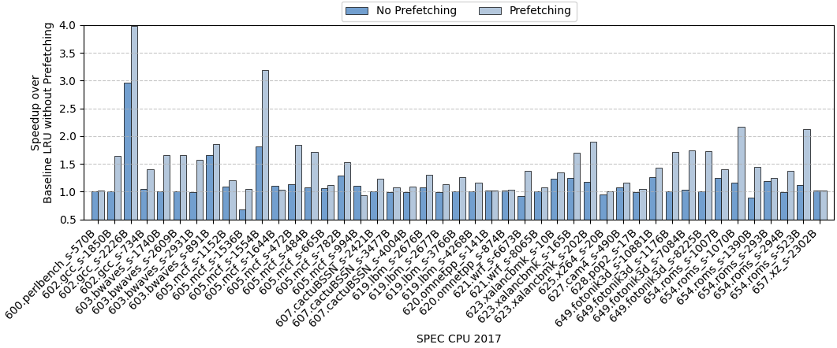
Recap of Checkpoint 1
Data Prefetcher at L1 : IPCP and L2: SPP
Replacement Policy at L1: LRU, L2: LRU and L3: MOCKINGJAY

Slide 4
Observation
We observe performance improvement across most of the traces in the presence of Prefetching.
Hence we run simulation for the individual techniques such as only Replacement policy, only Data Prefetcher and Combination of both Replacement policy + Data Prefetcher.
For better understanding we had separated the traces across three bins, these bins are:
  Positive
  Neutral
  Negative
Notes:
We observe performance improvement across most of the traces in the presence of Prefetching but we dont know that these performance improvement is it because of Rep. policy or prefetcher or both

Slide 5
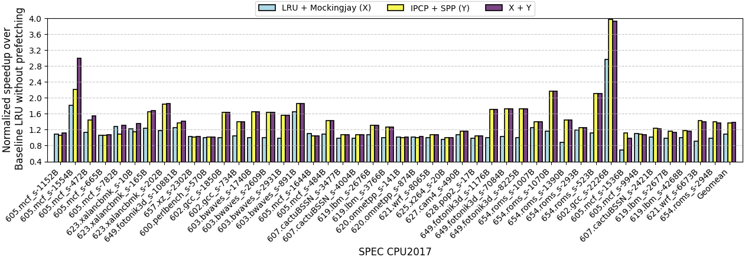
Interaction between LRU + Mockingjay (X) , IPCP + SPP (Y) and Combination of X and Y
Positive
Neutral
Negative
What is the reason behind these performance invariability?
Majority of traces (27 out of 45 traces) are showing neutral interaction
Positive Interaction: If speedup achieved by X + Y is greater than speedup of X and Y ​
Neutral Interaction: If speedup achieved by X + Y is equal to maximum speedup of X and Y ​
Negative Interaction: If speedup achieved by X + Y is less than speedup of X or Y ​

Slide 6
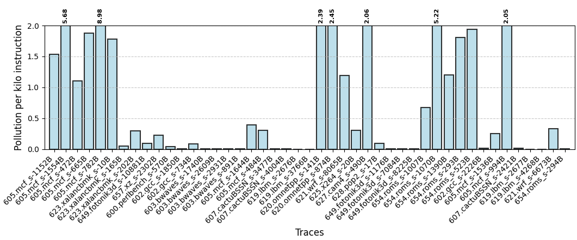
Pollution Per Kilo instruction at LLC when IPCP at L1D and SPP at L2
L2 : LRU , LLC : Mockingjay
We observe that around 93% of traces observe PPKI of less than 3 , irrespective of their interaction
Notes:
Probably is not the reason for the performance invariability hence we check different matrices such as demand mpki and prefetch accuracy

Slide 7
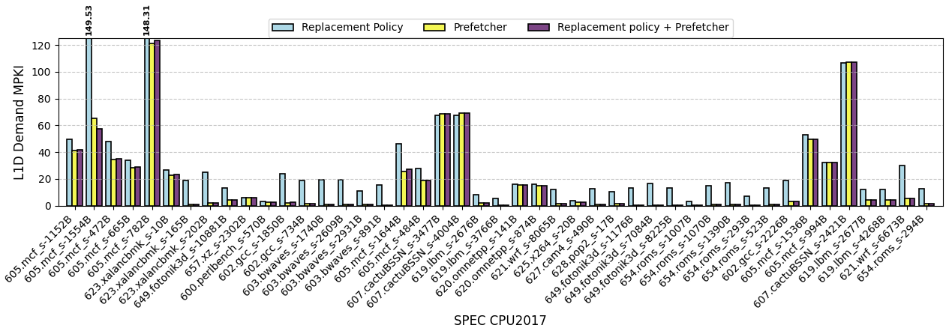
L1D Demand MPKI
Replacement policy
L1D: LRU
L2: LRU
LLC: Mockingjay
Data Prefetcher
L1D: IPCP
L2: SPP
Replacement policy + Data Prefetcher
L1D: IPCP L2: SPP
L1D: LRU, L2: LRU
LLC: Mockingjay
Positive Neutral Negative
L1D MPKI of Replacement policy and data prefetcher combination is less than compared to prefetcher and replacement policy for positive and interaction.
L1D MPKI of Replacement policy and data prefetcher combination is less than compared to prefetcher and replacement policy for positive and interaction.

Slide 8
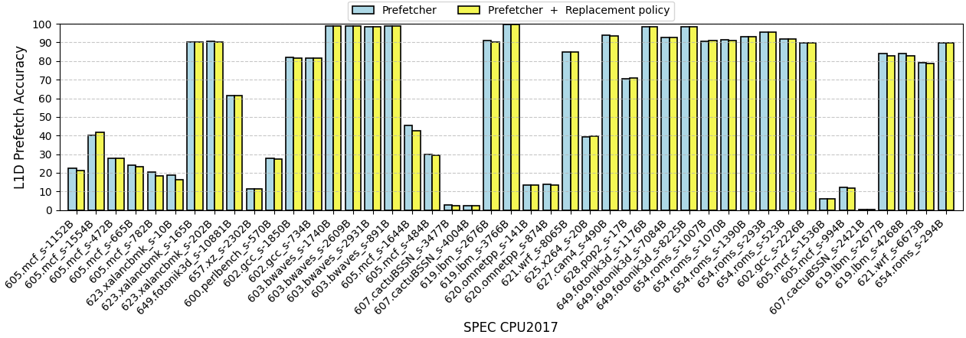
Prefetch Accuracy at L1D
On using replacement policy with the prefetcher IPCP + SPP we did not see any improvement in accuracy

Slide 9
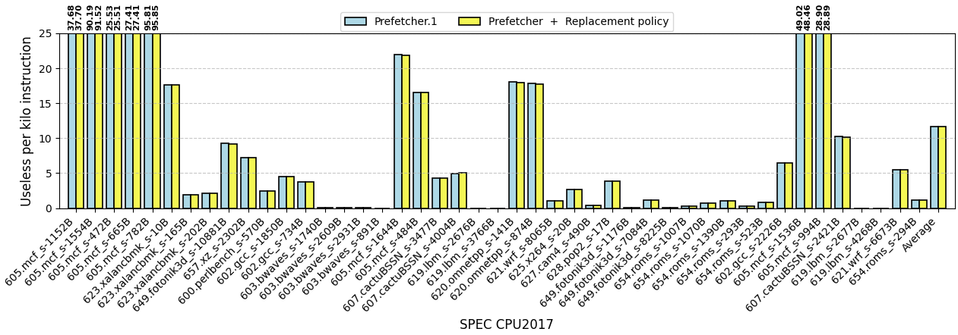
Useless Prefetch per kilo instruction at L1D
We see same no of Useless prefetch Per kilo instruction with replacement policy + Prefetcher and Prefetcher.

Slide 10
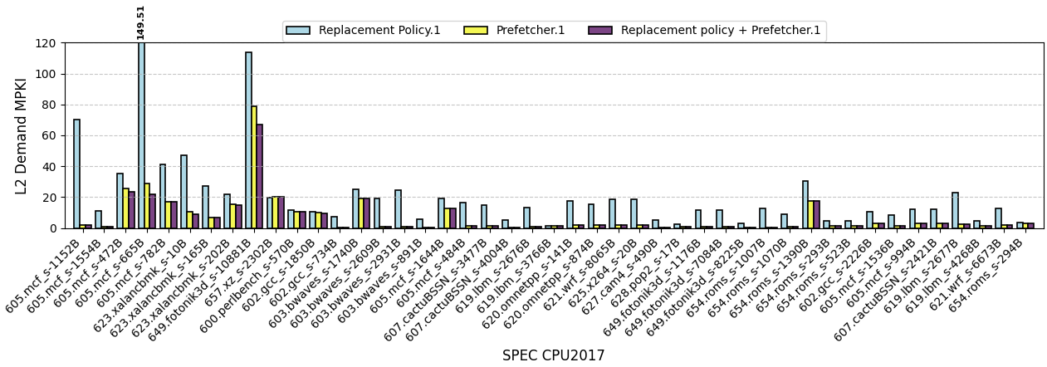
L2 Demand MPKI
Replacement policy
L1D: LRU
L2: LRU
LLC: Mockingjay
Data Prefetcher
L1D: IPCP
L2: SPP
Replacement policy + Data Prefetcher
L1D: IPCP L2: SPP
L1D: LRU, L2: LRU
LLC: Mockingjay

Slide 11
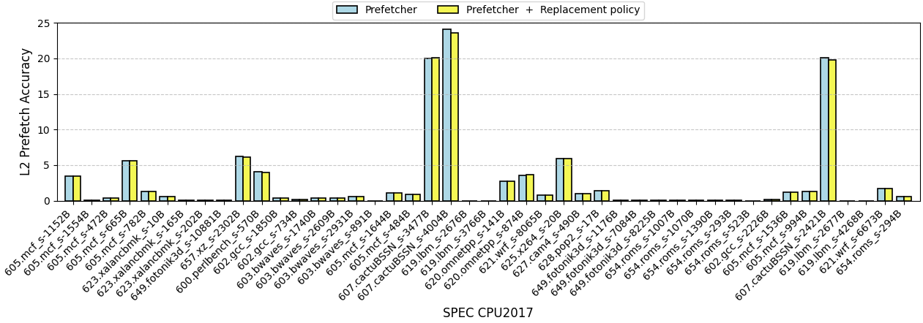
Prefetch Accuracy of L2

Slide 12
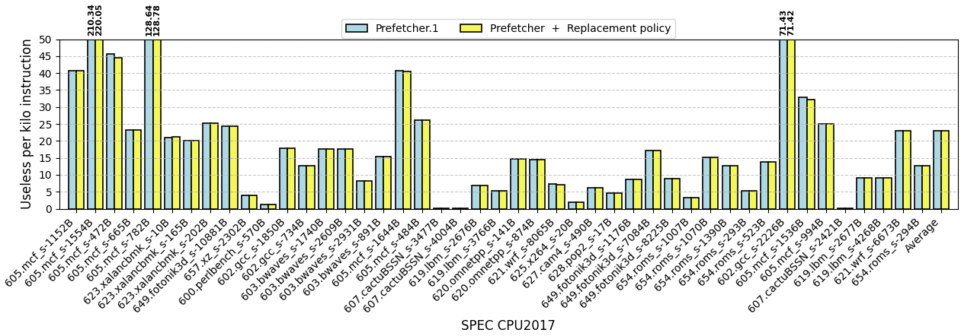
Useless Prefetch per kilo instruction at L2

Slide 13
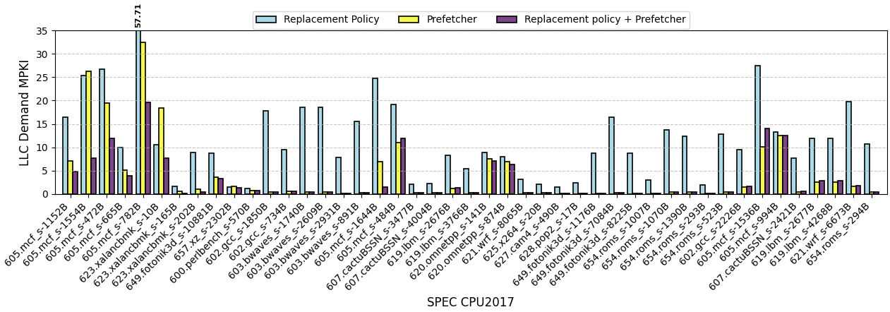
LLC Demand MPKI
Replacement policy
L1D: LRU
L2: LRU
LLC: Mockingjay
Data Prefetcher
L1D: IPCP
L2: SPP
Replacement policy + Data Prefetcher
L1D: IPCP L2: SPP
L1D: LRU, L2: LRU
LLC: Mockingjay
Positive Neutral Negative

Slide 14
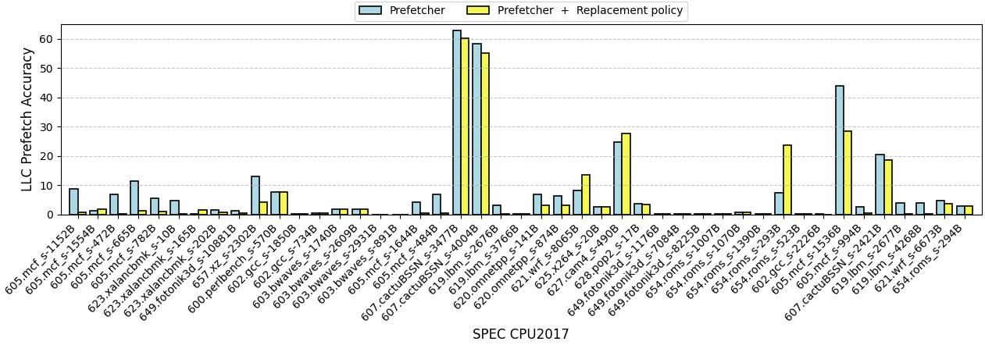
Prefetch Accuracy at LLC

Slide 15
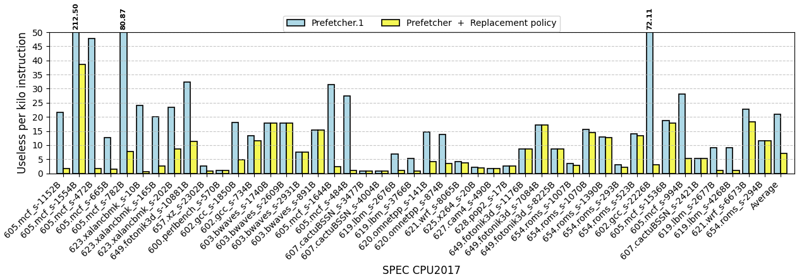
Useless Prefetch per kilo instruction at LLC

Slide 16
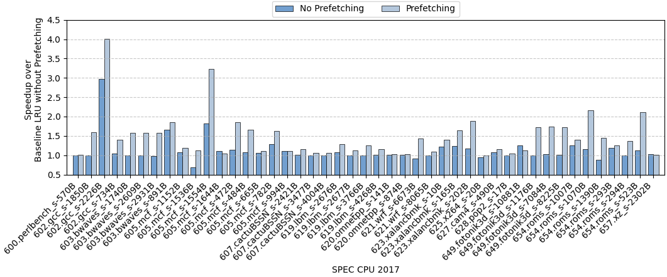
Shivam’s experiment
Trace gcc_s-2226B and mcf_s-1554B achieves speedup of 35.42% & 77.47 respectively in comparison with No Prefetching
Trace fotonik3d_s-10881B & xz_s-2302B on Prefetching shows degradation in speedup by ~3% & ~1% respectively in comparison with No Prefetching
Data Prefetcher at L1 : BERTI and L2: SPP
Replacement Policy at L1: LRU, L2: LRU and L3: MOCKINGJAY

Slide 17
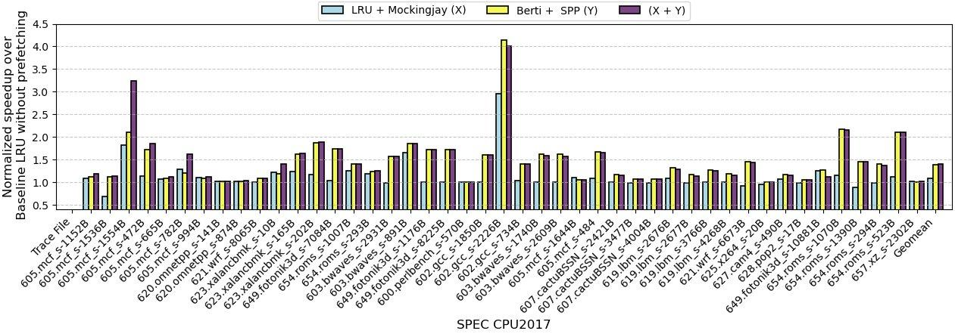
Interaction between LRU + Mockingjay (X) , BERTI + SPP (Y) and Combination of X and Y
Positive
Neutral
Negative
What is the reason behind these performance invariability?
Majority of traces (25 out of 45 traces) are showing negative interaction
Positive Interaction: If speedup achieved by X + Y is greater than speedup of X and Y ​
Neutral Interaction: If speedup achieved by X + Y is equal to maximum speedup of X and Y ​
Negative Interaction: If speedup achieved by X + Y is less than speedup of X or Y ​

Slide 18
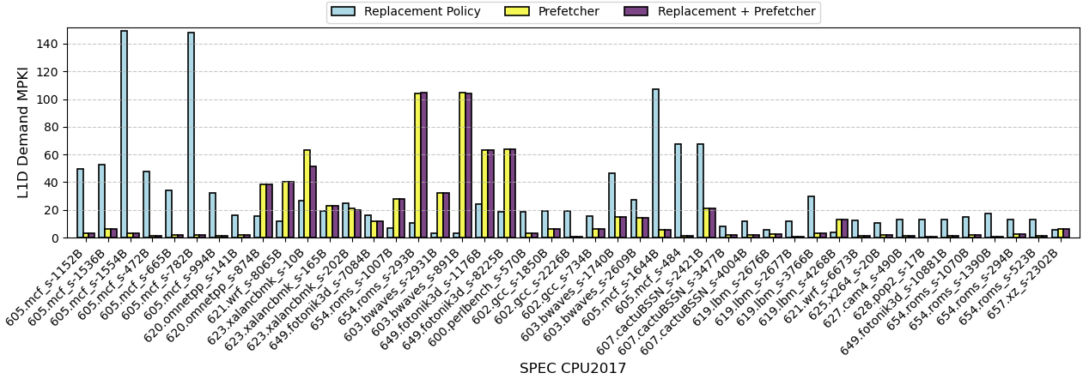
L1D Demand MPKI
Replacement policy
L1D: LRU
L2: LRU
LLC: Mockingjay
Data Prefetcher
L1D: BERTI
L2: SPP
Replacement policy + Data Prefetcher
L1D: BERTI L2: SPP
L1D: LRU, L2: LRU
LLC: Mockingjay
Positive Neutral Negative
L1D MPKI of Replacement policy and data prefetcher combination is less than compared to prefetcher and replacement policy for positive and interaction.
‹#›

Slide 19
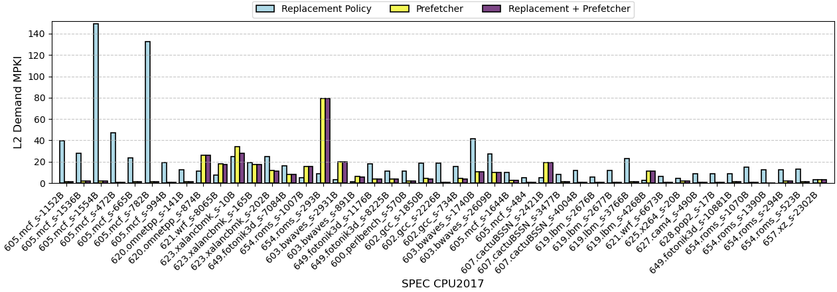
L2 Demand MPKI
Replacement policy
L1D: LRU
L2: LRU
LLC: Mockingjay
Data Prefetcher
L1D: BERTI
L2: SPP
Replacement policy + Data Prefetcher
L1D: BERTI L2: SPP
L1D: LRU, L2: LRU
LLC: Mockingjay
Positive Neutral Negative

Slide 20
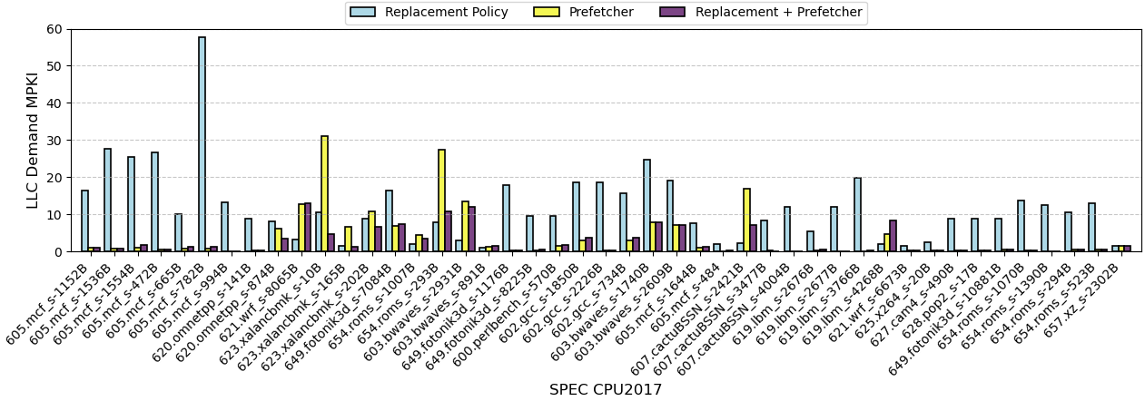
LLC Demand MPKI
Replacement policy
L1D: LRU
L2: LRU
LLC: Mockingjay
Data Prefetcher
L1D: BERTI
L2: SPP
Replacement policy + Data Prefetcher
L1D: BERTI L2: SPP
L1D: LRU, L2: LRU
LLC: Mockingjay
Positive Neutral Negative

Slide 21
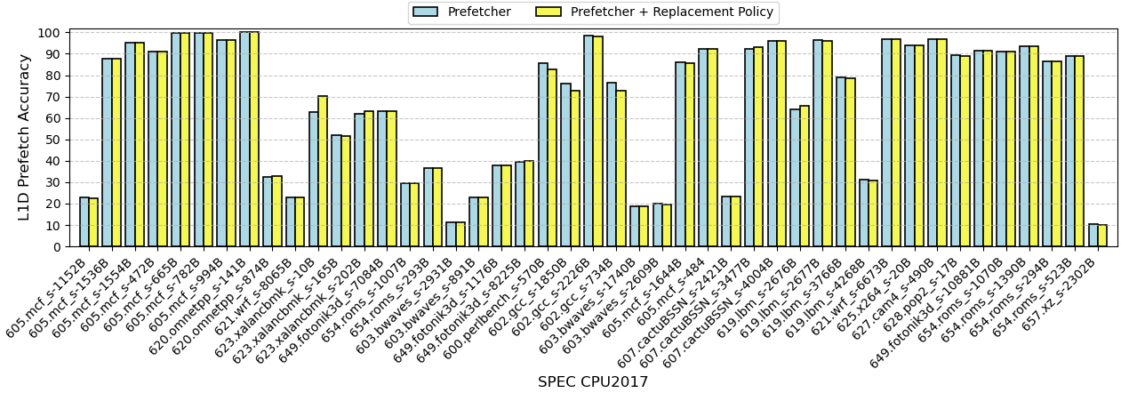
Accuracy of L1D Prefetcher
On using replacement policy with the prefetcher BERTI + SPP we did not see any improvement in accuracy

Slide 22
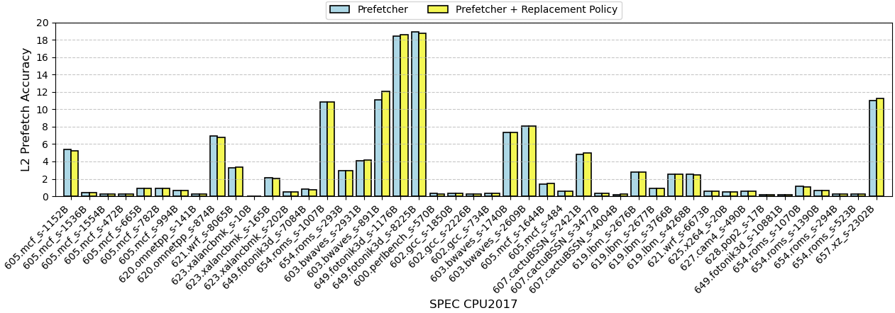
Accuracy of L2 Prefetcher

Slide 23
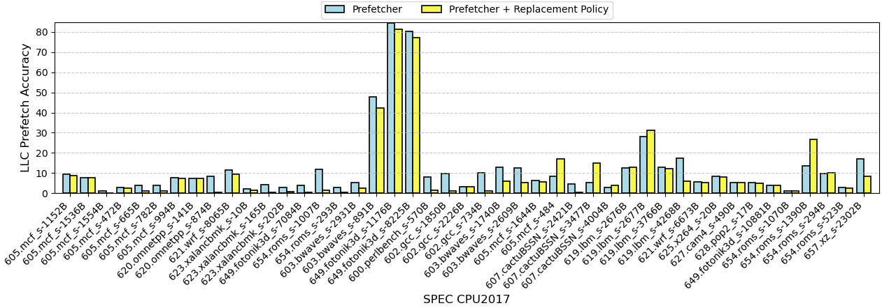
Accuracy of LLC Prefetcher

Slide 24
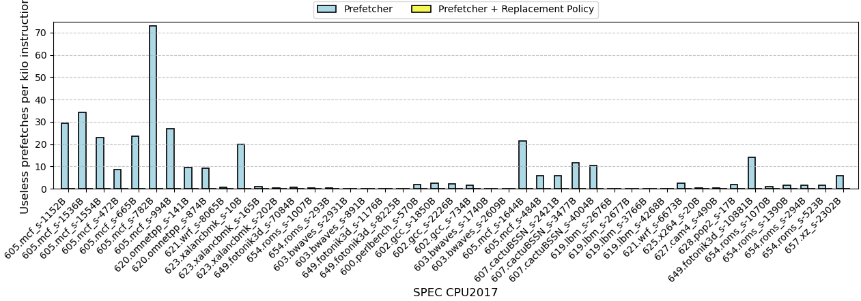
Useless Prefetch per kilo instruction at L1D

Slide 25
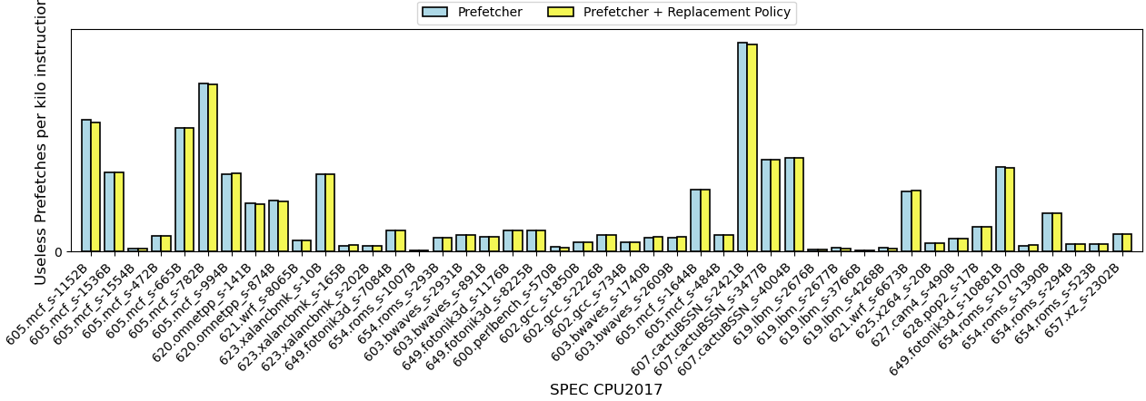
Useless Prefetch per kilo instruction at L2

Slide 26
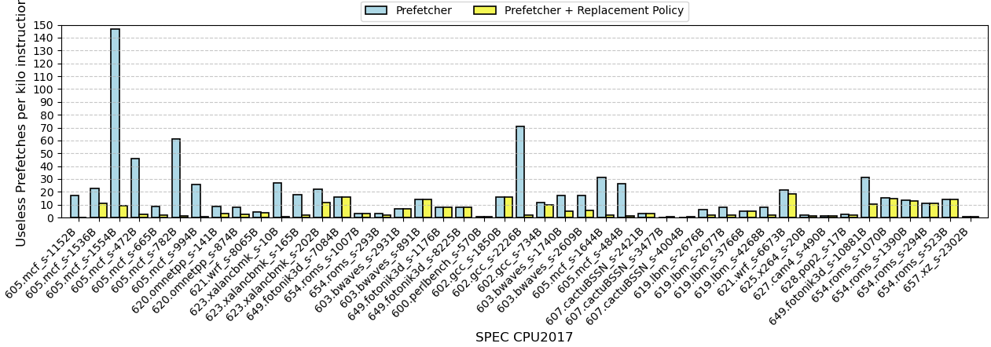
Useless Prefetch per kilo instruction at LLC

Slide 27
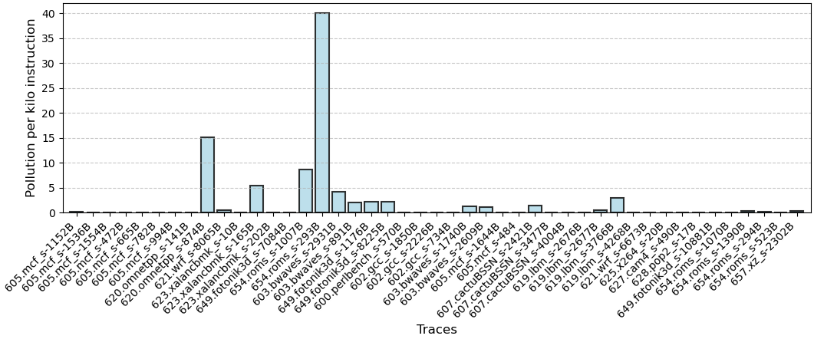
Pollution Per Kilo instruction at LLC when BERTI at L1D and SPP at L2
L2 : LRU , LLC : Mockingjay
We observe that around 86.66% of traces observe PPKI of less 3.
Notes:
Probably is not the reason for the performance invariability hence we check different matrices such as demand mpki and prefetch accuracy

Slide 28
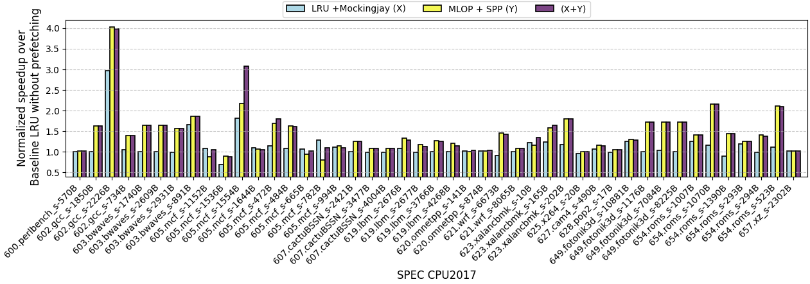
Interaction between LRU + mockingjay(X ) MLOP + SPP (Y) and combination X+Y

Slide 29
Github Link
https://github.com/Striender/CS683_Course_Project.git

